Slide 1
Senior System Design CpE 190 and EEE 193A
WBS and Schedule
Week 3

Slide 2
Planning the Project
“You can’t schedule creativity” [1]
“You can schedule creativity, within limits” [1]
So which is – can you schedule or not?
There is a trick
– estimate.
If it is just a guess, why bother? (see next slide)

Slide 3
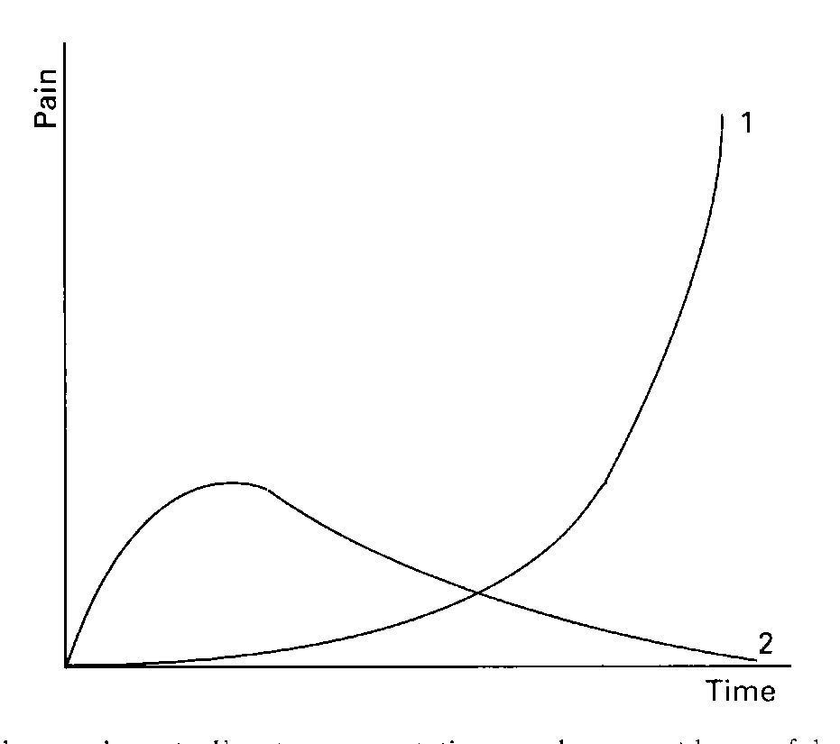
Planning the Project
Two pain curves theory.
Curve 1 – no plan
End strategy - blame someone else
Curve 2 – successful planning – end with no pain!
Vote for curve 2 in your projects.

Slide 4
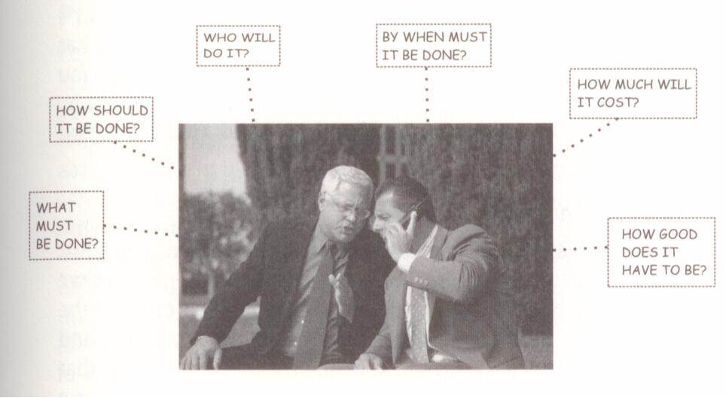
Planning the Project
Planning Defined [1]
Answer the following questions:
Who, What, When, Why, How Much, How Long

Slide 5
Planning the Project
Suggestions for Effective Planning [1]
Plan to Plan
The plan doers should participate in preparing the plan.
Be prepared to replan.
Always conduct a risk analysis to anticipate likely but unexpected obstacles.

Slide 6
Work Breakdown Structure
How do you define “chewable chunks” for each team member?
Two related concepts will be discussed:
Work Breakdown Structure – divide and conquer
Program Evaluation and Review Technique – visualize flow

Slide 7
WBS
Work Breakdown Structure [2]
– DOD Military Standard MIL-STD 881B
Reflects a top-down approach to planning.
This process consists of subdividing a total project into smaller and more easily managed elements.
WBS – defines the products to developed and/or produced. This is the view of the deliverables and not the tasks.
Continue the process until the desired level of detail is reached.

Slide 8
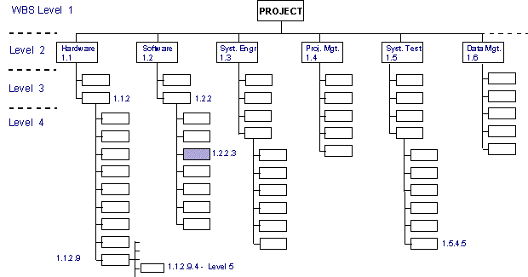
Figure I. WBS Format for System Development Projects [2]

Slide 9
WBS
Your WBS design should achieve the following goals: [3]
Be compatible with how the work will be done.
Give visibility to important or risky work efforts.
Allow mapping of requirements, plans, testing and deliverables.
Foster clear ownership by team leaders and team members.
Provide data for performance measurement.
Make sense to the team members and the instructor.

Slide 10
WBS
The Big 3 [3]
The WBS must be mutually exclusive.
Elements do NOT overlap.
The WBS must follow the 100% rule.
The elements add up to 100% of the project.
Know when enough is enough
If you can reasonable predict the time to complete the task – you are probably at enough detail.

Slide 11
PERT
Program Evaluation and Review Technique - PERT
The U.S. Navy developed this technique during the development of the Polaris missile due to the increasingly technical nature of their warfare enhancement projects.
Complex technical projects can have complex interactions between tasks, timing of tasks, and project team members.
Rather than relying on gifted, experienced but possibly only intuitive project managers, the PERT method creates a project structure that is:
visible to all project members,
clear in assignment of tasks,
avoids duplication by this transparency,
and, above all, based on clear convincing logic.

Slide 12
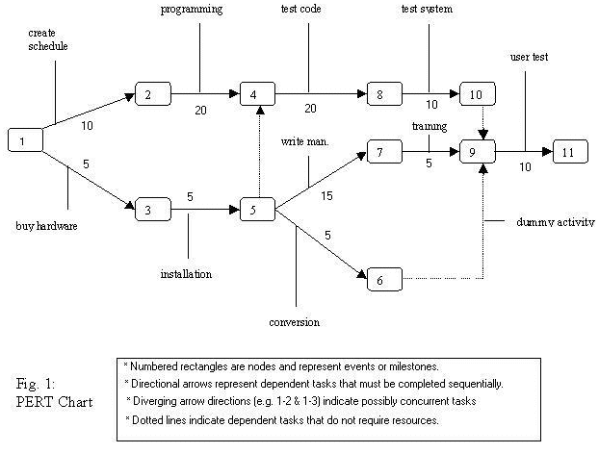
Figure II. PERT Chart [4]

Slide 13
PERT
Criteria to use PERT [5]
1. Does a specific end objective exist?
Your design idea must result in a working deployable prototype.
2. Must some scheduled date or deadline be met?
You must complete a working laboratory prototype by May.
You must complete a working deployable prototype by December.

Slide 14
PERT
Criteria to use PERT [5]
3. What is the degree of project complexity?
Dr. Cook indicates the minimum complexity is:
more than two persons;
more than two months;
PERT “network” of 20 to 25 “events.”
Senior Design:
about four persons;
about ten months;
PERT “network” of up to hundreds of “events.”

Slide 15
PERT
Criteria to use PERT [5]
4. Does a degree of uncertainty exist as to the definition of some or all of program elements?
How many students in the course can tell me know exactly what they need to do, when they will do it and what exact parts, circuits, printed circuit boards, software, algorithms, …. are needed?
Zero? I thought so.
There is an old adage:
Plan your work.
Work your plan.

Slide 16
PERT
Senior Design WBS/PERT process:
Construct a work breakdown structure
These are the tasks required to implement features that define your project.
Correlate the “network” to the WBS.
The buzzword “network” means what are the project processes that must be followed to complete your task?

Slide 17
PERT
For example, how do you drive to school in the morning?
Get dressed.
Eat breakfast. You might be able to skip eating breakfast, but don’t skip getting dressed.
Gather up books, homework, and stuff into backpack.
Find car keys. Maybe you take Light Rail.
Go to car. Unlock car. Get in car. Start car. ……..
And so on.
Without trying to describe exactly “how you start a car”, can you describe the various processes that you will need to complete to finish Senior Design?

Slide 18
PERT
Important Point!
PERT is a dynamic system. Any project probably will not progress exactly according to plan.
Develop a mindset that includes periodic task and schedule revisions as a central element in your planning.
Weave and dodge as obstacles arise. But keep your eye on the completion of the project.
Senior Design ends in December. Period. The clock will tick on relentlessly. Completing school and your graduation depend on finishing your Senior Design project.

Slide 19
REFERENCES
[1] J.P. Lewis, Fundamentals of Project Management, 3rd ed., New York, 2007
[2] D.L. Cook, 1966, Program Evaluation and Review Technique – Applications in Education, U.S. Department of Health, Education and Welfare, Office of Education,
Available: http://eric.ed.gov/
[3] J.R. Chapman, 2007, Principle Based Project Management, Available: http://www.hyperthot.com/pm_wbs.htm
[4] P. Bergdhal, Work breakdown structure user guide, Available: http://www.youtube.com/watch?v=5DyjLFVMVso&NR=1
[5] M. Kelly, PERT, PERT Chart Tutorial, McKinnon Secondary College, Victoria, Australia, Available: http://www.vceit.com/ganttpert/pert-tute/pert-tute.htm

Slide 20
Senior System Design CpE 190 and EEE 193A
WBS and Schedule
Week 3

